Slide 1


Data to information

Slide 2
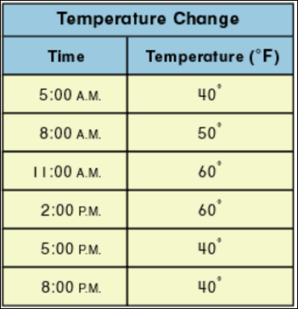
Data
Data are individual facts and figures that have been collected.
Data is often called raw data because it has not been processed by a computer. Examples of raw data include:
Time
Measurement
Temperature
Test results
Crowd numbers
Prices
Data is used as input into an information system.

Slide 3
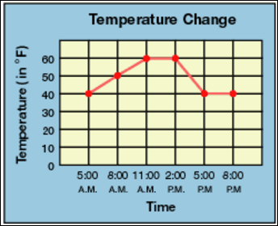
Information
Information is data that has been processed, using an information system, into a more useful form. Examples of information include:
Books
Websites
Games
Newspapers
Letters
Graphs
Movies
Information is used as output of an information system.

Slide 4
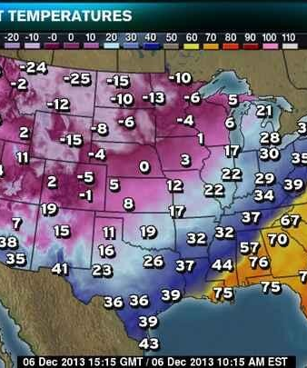
Purpose of information
Data is processed into information because information is more meaningful to users.
Users are people who use information and communication technology (ICT).
Information presents raw data in easy to understand format, that allows the user to quickly and easily understand the meaning of the data.

Slide 5
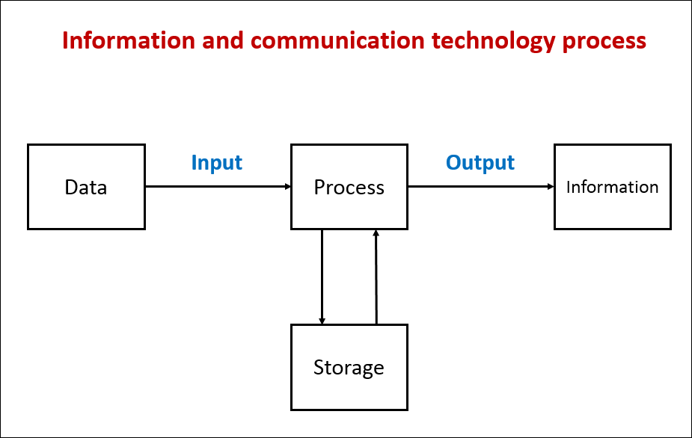
ICT process
The purpose of information and communication technology (ICT) is to convert data into information.

Slide 6
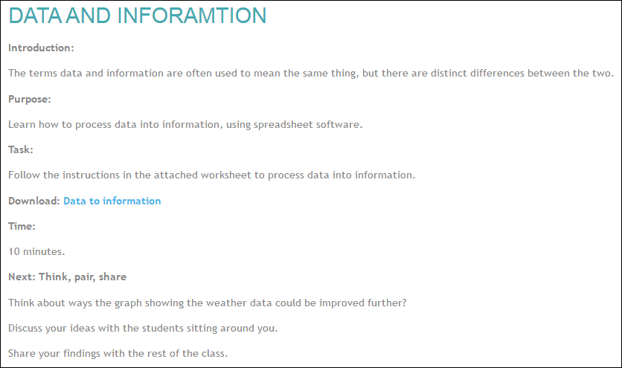
Activity: data to information
Go to elearn and complete the data to information activity.

Slide 7
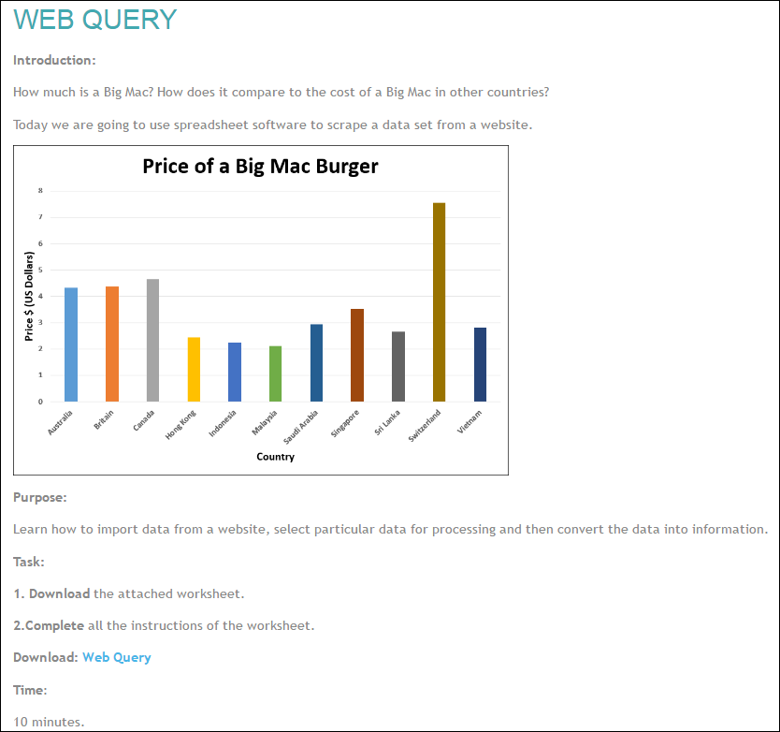
Activity: web query
Now go to elearn and complete the web query activity.

Slide 8
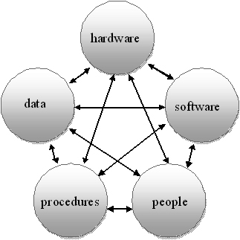
Information systems
Hardware and software alone cannot process data into information.
Other components are needed to create information.
Notes:
Image reference: http://smklunduictclass.blogspot.com.au

Slide 9
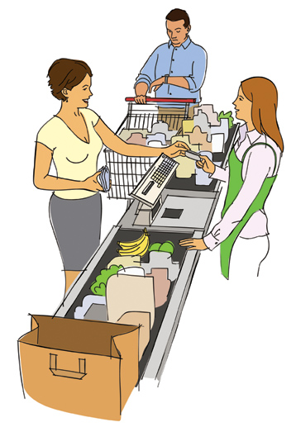
Information systems
An information system is used to process data into information.
An information system consists of four components:
Data
Hardware & software
People
Procedures
All four components are required to create information.

Slide 10
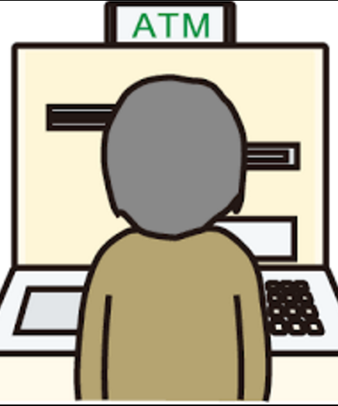
Information systems
Examples of information systems include:
Supermarket checkout
Library borrowing system
Web search engine
Automatic teller machines
Online shops
Online banking
Video streaming
GPS navigation
Employee pay calculator

Slide 11
Information systems
Identify the following components for an ATM system:
Data
Hardware and software
People
Procedures

Slide 12
Information systems
Identify the following components for an ATM system: Data PIN number Withdrawal amount Hardware and software Card reader Keyboard Operating system Bank transaction software People Customer Procedures
Insert card Input amount Print receipt Others?

Slide 13
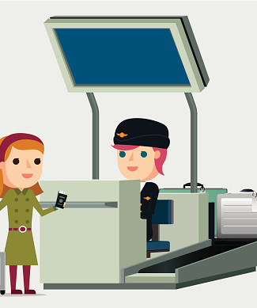
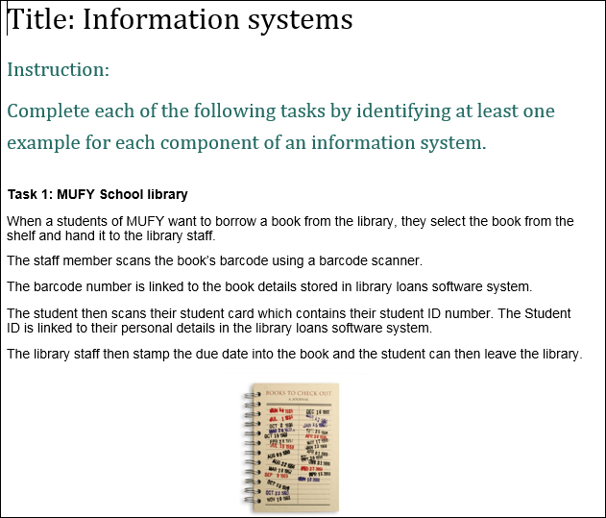
Activity: Information systems
Complete the information systems activity on elearn.

Slide 14
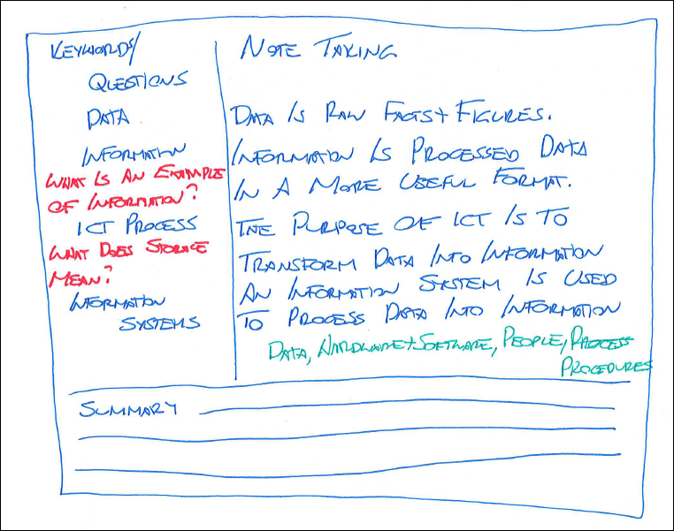
Cornell notes
The pre-class activity involved creating a template to be used for Cornell notes.
Let’s now create notes about today’s class.
Areas covered included:
Data
Information
ICT Process
Information systems

Slide 15
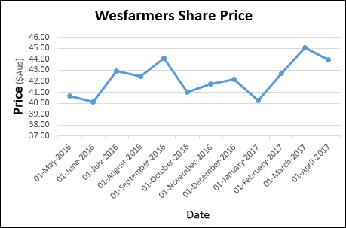
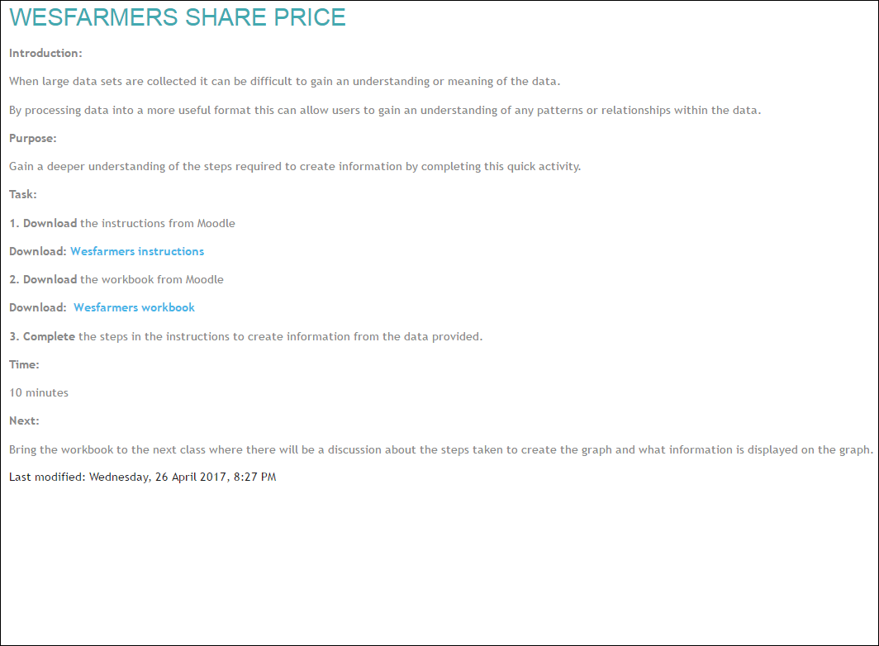
Post-class activity
Complete the Wesfarmers Share Price activity on elearn

